Slide 1
Anomaly detection of water quality monitoring

Slide 2
The Challenge: Maintaining Water Quality
Water contamination can arise from various sources, including:
Industrial waste
Agricultural runoff
Sewage leaks
Natural disasters
Contaminated water can pose significant health risks, causing diseases like cholera, typhoid, and dysentery.

Slide 3
The Role of Sensor Data
Sensor networks play a crucial role in water quality monitoring:
Continuously collect data on various water quality parameters like:
pH level
Temperature
Conductivity
Turbidity
Dissolved oxygen
Real-time data collection enables prompt identification of potential issues.

Slide 4
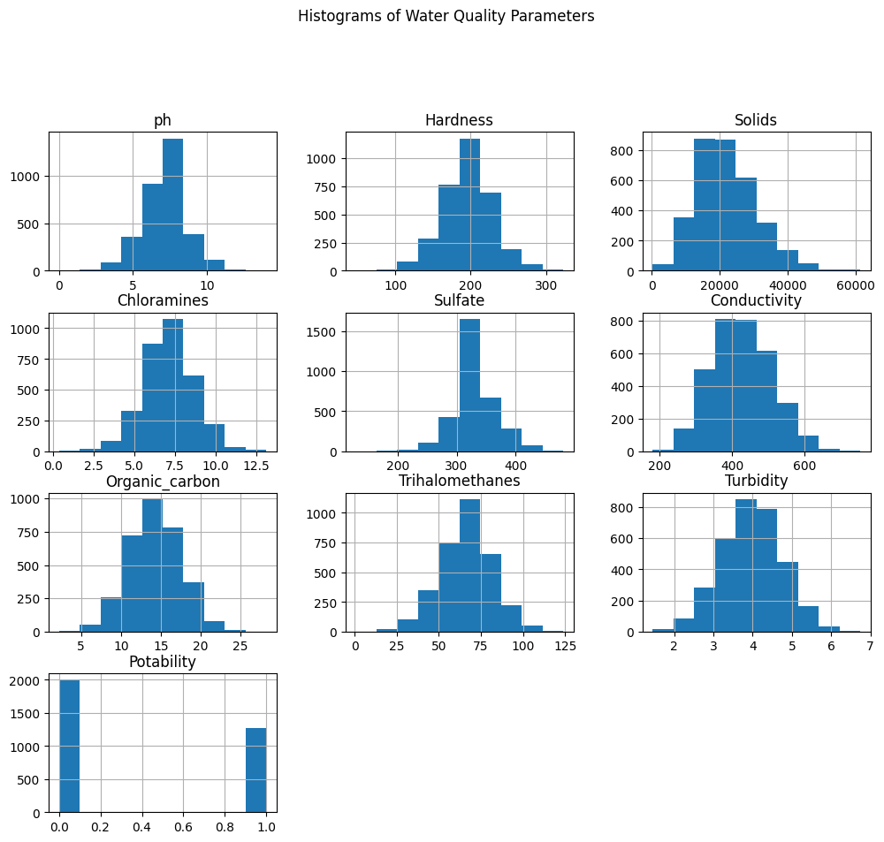
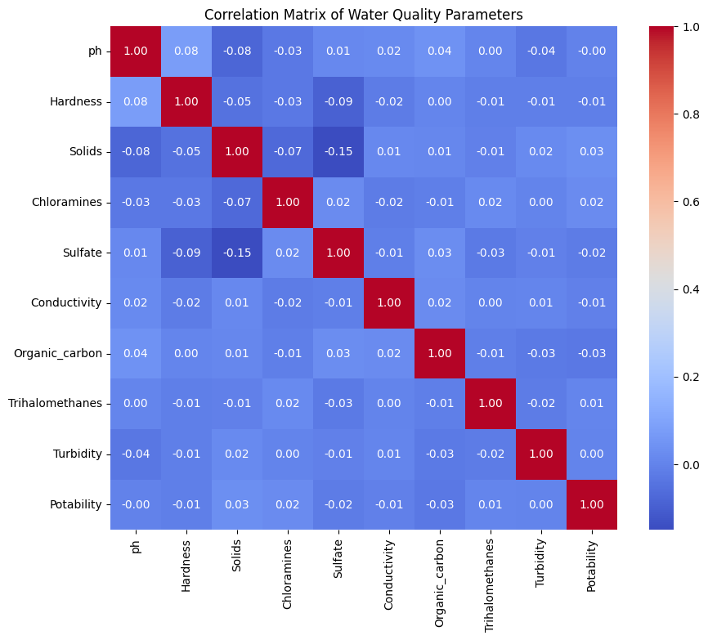
Graphical representation

Slide 5
Anomaly Detection with Machine Learning
Machine learning algorithms can be utilized to detect anomalies in water quality data:
Anomaly detection algorithms identify patterns that deviate significantly from the expected behavior.
These deviations might signal potential contamination events.
Common anomaly detection techniques include:
Isolation Forest
Local Outlier Factor (LOF)
One-Class Support Vector Machines

Slide 6
outputs
isolaton forest {'Accuracy True False (False Negative)': 0.0, 'Accuracy True True (True Positive)': 41.49659863945578, 'Accuracy': 37.19512195121951}
random forest classifer {'Accuracy True False (False Negative)': 74.50271247739603, 'Accuracy True True (True Positive)': 42.21311475409836, 'Accuracy': 69.4328518592563}
Loacl Outlier factor {'Accuracy True False (False Negative)': 0.0, 'Accuracy True True (True Positive)': 37.423312883435585, 'Accuracy': 37.19512195121951}
LogisticRegressioni {'Accuracy True False (False Negative)': 62.80487804878049, 'Accuracy True True (True Positive)': 0.0, 'Accuracy': 62.80487804878049}

Slide 7
Benefits of Anomaly Detection
Early detection of water quality anomalies offers numerous benefits:
Enables prompt response to contamination events.
Minimizes the spread of waterborne diseases.
Protects public health and safety.
Optimizes water treatment processes.
Reduces environmental damage.

Slide 8
Conclusion
Anomaly detection in water quality monitoring is a powerful tool for safeguarding this vital resource.
By leveraging sensor data and machine learning algorithms, we can identify potential contamination events early on.
This proactive approach protects public health, optimizes water treatment processes, and minimizes environmental damage.

Slide 9
Thank you

